Slide 1
SEBA Undergraduate Intern Panel

Slide 2
Current Events

Slide 3
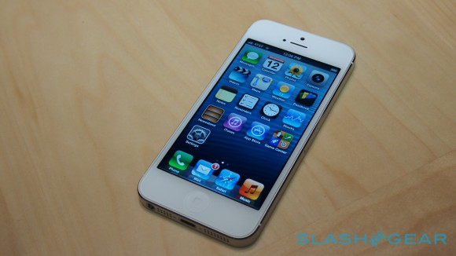
Apple Stock is over $700 for first time
Came after the much anticipated iPhone 5 was announced. Price was around $660 before
Has bigger screen and custom processor
Crushed iPhone 5 preorder record
Over 2 million
in 24 hours
Over double 4s

Slide 4
QE3
Quantitative Easing round 3
Fed announced on Thursday that it would continue the purchase $85 billion of assets a month to boost the economy and help reduce unemployment
QE adds money to the economy by buying assets. This reduces long term interest rates thus giving more incentive for investors to spend their money now.

Slide 5
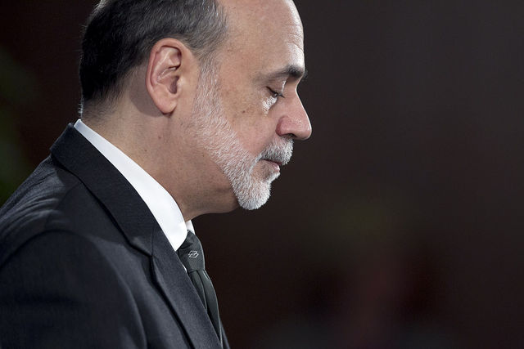
Results
QE1 (2008) was viewed as effective in preventing the economy from falling further into depression
QE2 (2010) had more debatable results
Stocks responded well
last week but have
slowly declined so
far this week

Slide 6
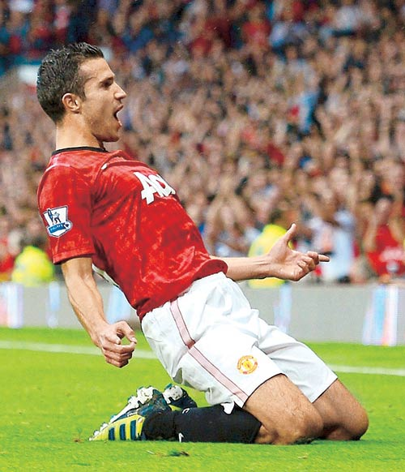
Manchester United on NYSE
Manchester United went public back in August
Released first earnings report yesterday
Disappointing loss of about $25 million because they were knocked out of 2 major tournaments early.
This resulted in much less
profit than last year due
to less big games to collect
revenue from.

Slide 7
Stock Competition Update
Who’s Hot : Luke – Apple
Pauline – Chipotle
Lucas – Apple
Who’s Not: Mike – Bank of America
Will – Electronic Arts
Alec - Netflix

Slide 8
Intern Panel
Kyle Yost – JP Morgan Chase
Anthony Maers – UBS Financial Services Lawrence Associates
Alex Agne – TRW Automotive
Michael Alvarino – La Buena Onda Hostel and Cafe

